Slide 1
MSIT 3860
Final Project Template

Slide 2
Part 1: Business Presentation

Slide 3
Instructions
The next slide gives questions for you to answer using the Yelp dataset. See the final project instructions file for details.
Add a new slide for each question.
Give the slide a short, but descriptive title
Put the question you are answering on the slide.
Use text, images, and graphs to answer the question.
Please pay attention to presenting your answers clearly. Imagine giving this presentation in a professional setting!
You may delete this instructions slide in your final report.

Slide 4
Business questions
How many users have joined Yelp each year since 2010?
How many users were elite in each of the 10 years from 2012 through 2021? Does it look like the number of elite users is increasing, decreasing, or staying about the same?
Which of our users has the most 5-star reviews of all time? Give us the person’s name, when they joined Yelp, how many fans they have, how many funny, useful, and cool ratings they’ve gotten. Please also gives us 3-5 examples of recent 5-star reviews they have written.
We’d like to talk with users who have lots of friends on Yelp to better understand how they use the social features of our site. Can you give us user id and name of the 10 users with the most friends?
Which US states have the most businesses in our database? Give us the top 10 states.
What are our top ten business categories? In other words, which 10 categories have the most businesses assigned to them?
What is the average rating of the businesses in each of those top ten categories?
We’re wondering what makes users tag a Restaurant review as “funny”. Can you give us 5 examples of the funniest Restaurant reviews and 5 examples of the 10 least funny? We’d also like you to look at a larger set of funny and unfunny reviews and tell us if you see any patterns that separate the two. (We know the last part is qualitative, but tell us anything you see that may be useful.)
We think the compliments that tips receive are mostly based on how long the tip is. Can you compare the average length of the tip text for the 100 most-complimented tips with the average length of the 100 least-complimented tips and tell us if that seems to be true? (Hint: you will need to use computed properties to answer this question).
We are trying to figure out whether restaurant reviews are driven mostly by price range, how many hours the restaurant is open, or the days they are open. Can you please give us a spreadsheet with the data we need to answer that question? (Note from Professor Augustyn: You don’t actually have to hand in a spreadsheet…just give me a table with 10 rows of sample data returned by your query.)

Slide 5
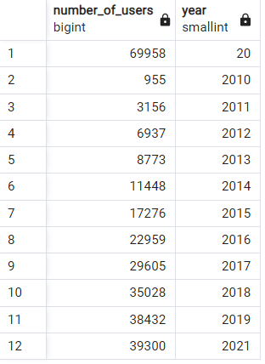
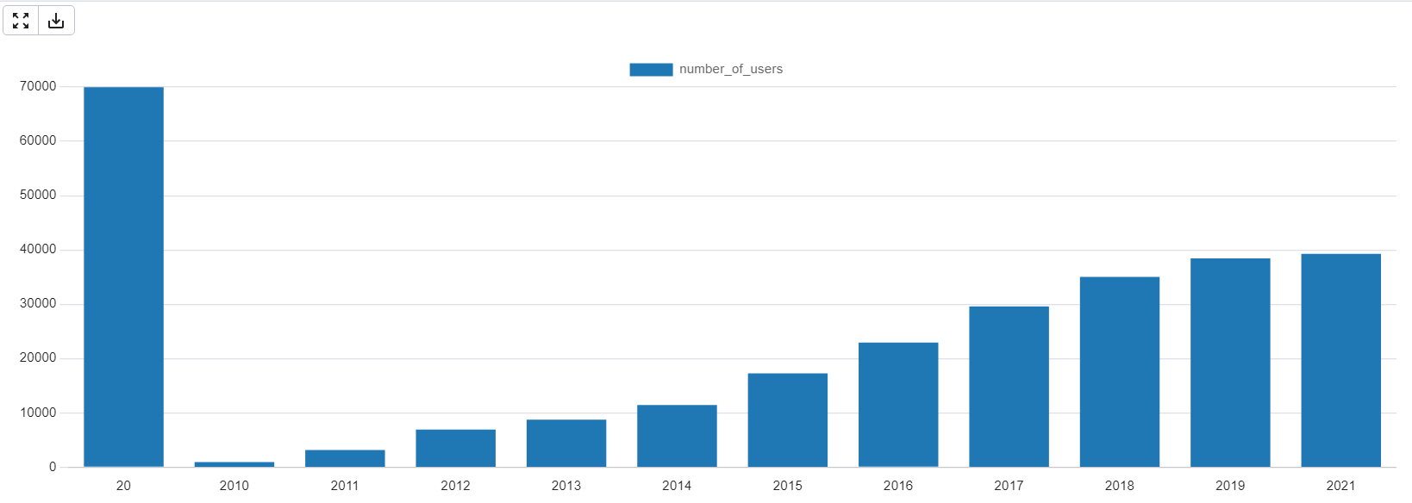
Users joining Yelp each year since 2010
Q1. How many users have joined Yelp each year since 2010?

Slide 6
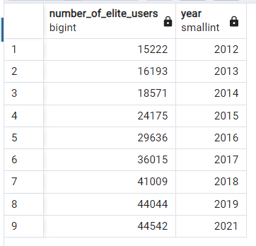
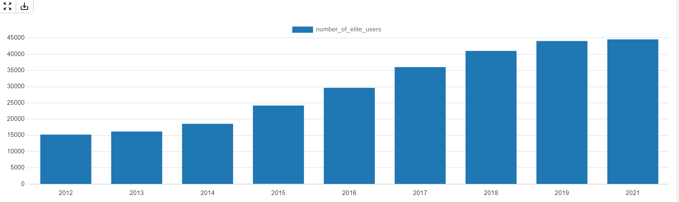
No. of elite users each year from 2012-2021
Q2.How many users were elite in each of the 10 years from 2012 through 2021? Does it look like the number of elite users is increasing, decreasing, or staying about the same?

Slide 7
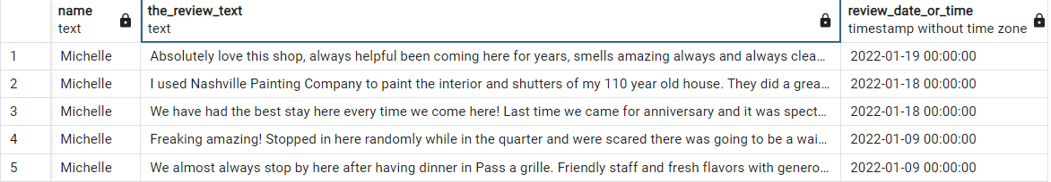
User with the highest no. of 5-star reviews and other details of that person
Q3.Which of our users has the most 5-star reviews of all time? Give us the person’s name, when they joined Yelp, how many fans they have, and how many funny, useful, and cool ratings they’ve gotten. Please also gives us 3-5 examples of recent 5-star reviews they have written.

Slide 8
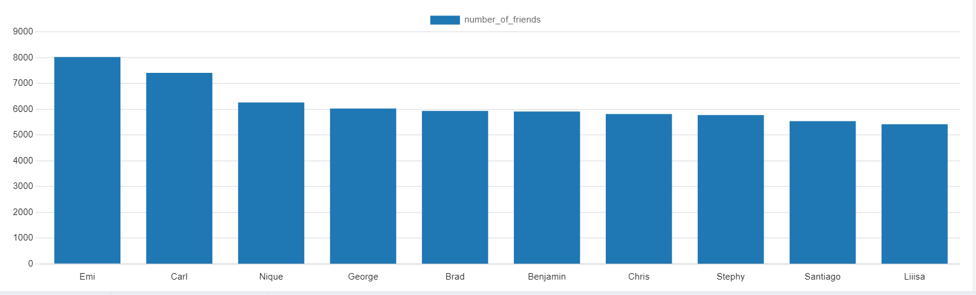
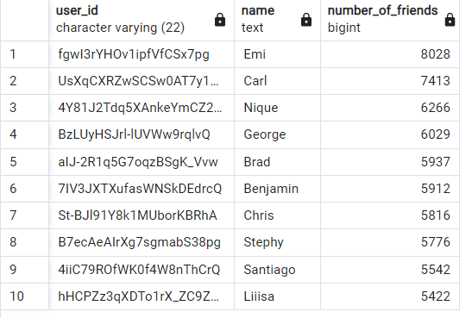
Users with most friends
Q4. We’d like to talk with users who have lots of friends on Yelp to better understand how they use the social features of our site. Can you give us user id and name of the 10 users with the most friends?

Slide 9
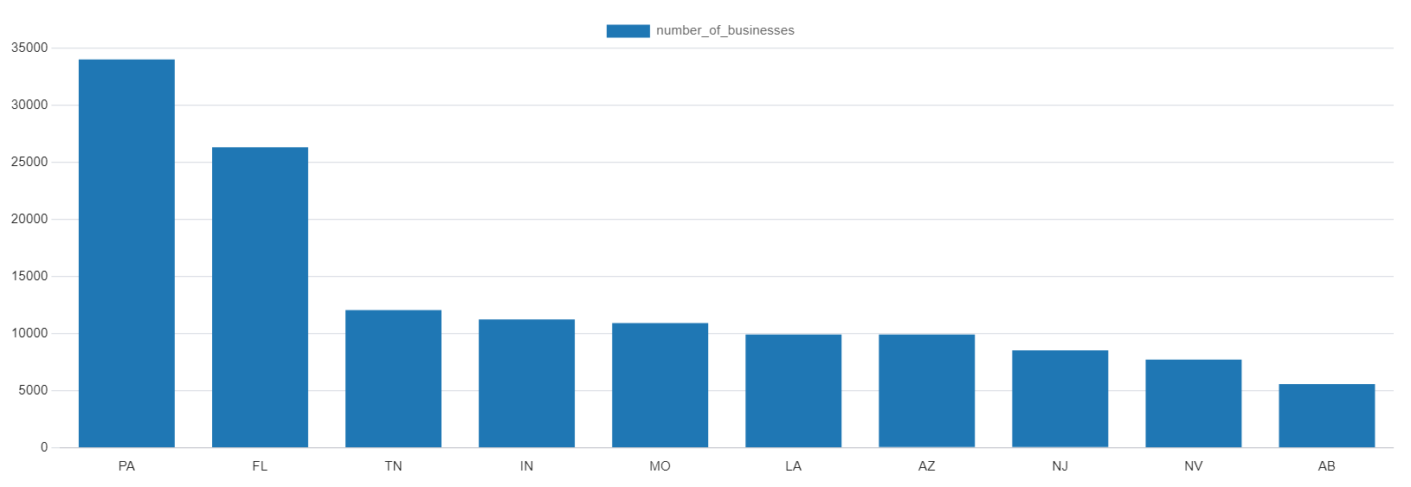
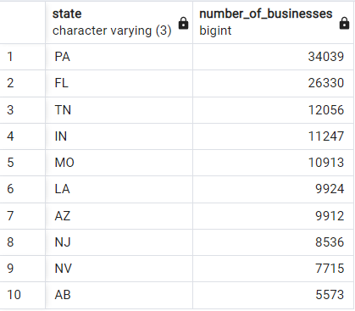
States with the most number of businesses
Q5 Which US states have the most businesses in our database? Give us the top 10 states.

Slide 10
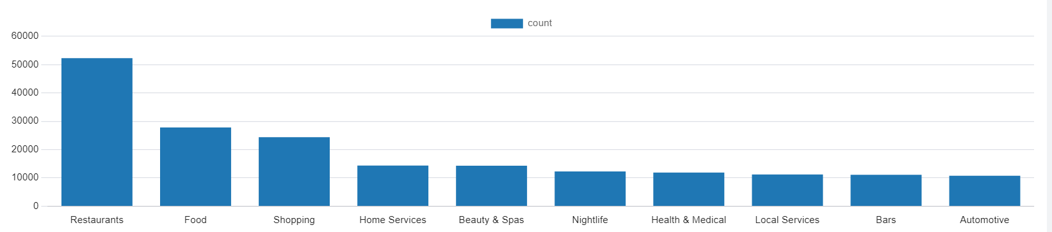
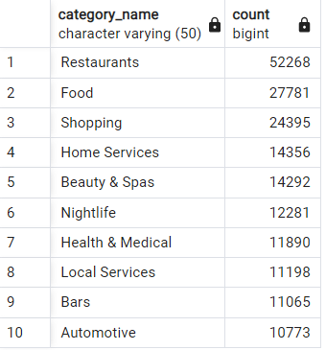
Top 10 business categories
Q6 What are our top ten business categories? In other words, which 10 categories have the most businesses assigned to them?

Slide 11
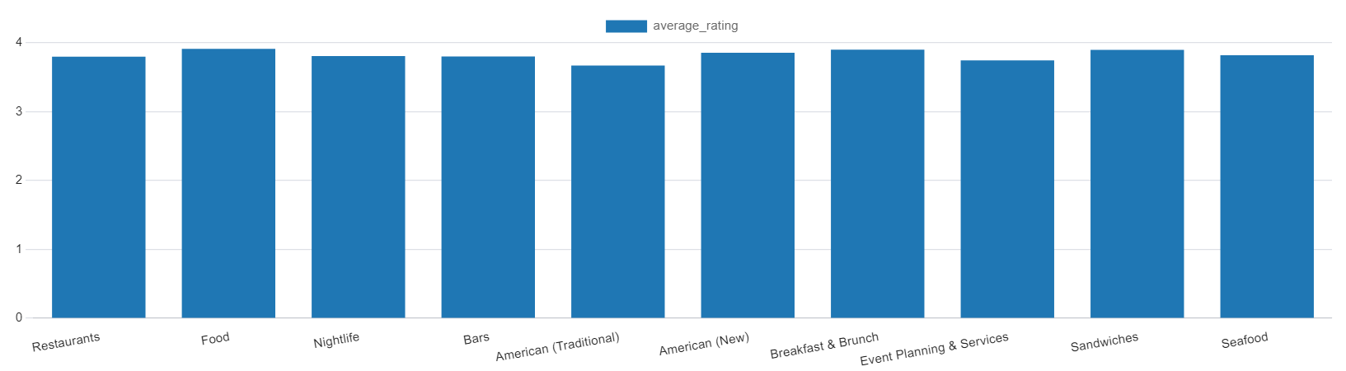
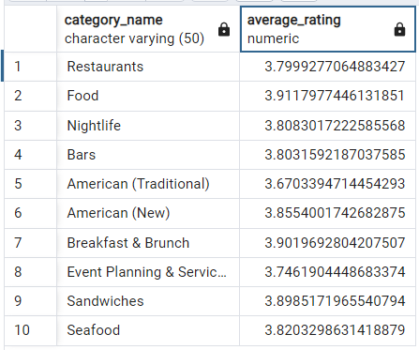
Average ratings of top ten business categories
Q7 What is the average rating of the businesses in each of those top ten categories?

Slide 12
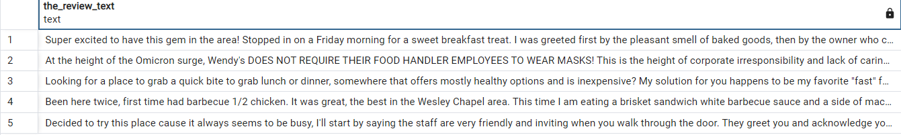
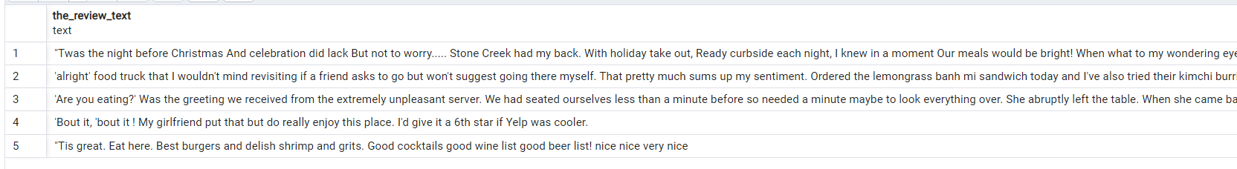
Restaurant’s least & most funny reviews
Q8 We’re wondering what makes users tag a Restaurant review as “funny”. Can you give us 5 examples of the funniest Restaurant reviews and 5 examples of the 10 least funny? We’d also like you to look at a larger set of funny and unfunny reviews and tell us if you see any patterns that separate the two. (We know the last part is qualitative, but tell us anything you see that may be useful.)
Funniest reviews
Least funny reviews

Slide 13
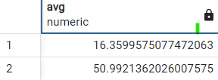
Average length of 100 most complimented and 100 least complimented reviews
We think the compliments that tips receive are mostly based on how long the tip is. Can you compare the average length of the tip text for the 100 most-complimented tips with the average length of the 100 least-complimented tips and tell us if that seems to be true? (Hint: you will need to use computed properties to answer this question).
Average length of 100 most complimented reviews
Average length of 100 least complimented reviews

Slide 14
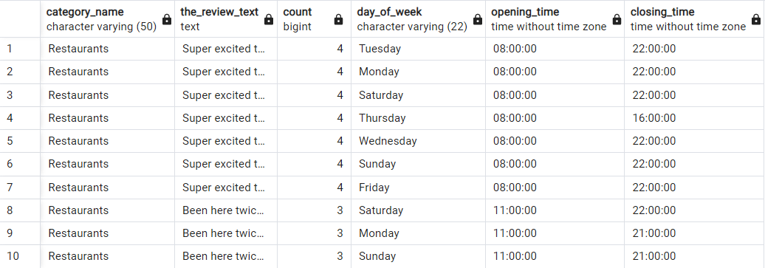
Checking whether restaurant reviews are driven by how many hours they are open or the days they are open
Q10 We are trying to figure out whether restaurant reviews are driven by how many hours the restaurant is open, or the days they are open. Can you please give us a spreadsheet with the data we need to answer that question? (Note from Professor Augustyn: You don’t actually have to hand in a spreadsheet…just give me a table with 10 rows of sample data returned by your query.)

Slide 15
Extra credit
This is a very rich dataset that can be used to answer many interesting questions.
For up to 10 points of extra credit, make up some of your own queries, answering other questions you think are interesting.
You will receive up to 2 points of extra credit for each original query you create. Simple queries (involving just one table) will be worth 1 point, more complex queries involving multiple tables will be worth 2 points.
Make a new slide for each original query, formatted the same as the ones answering the main business questions.

Slide 16
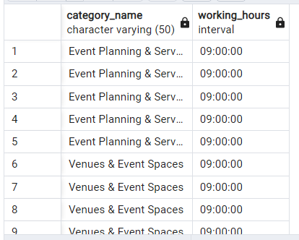
Working hours less than 10
Q11 Select business categories with working hours less than equal to ten.

Slide 17
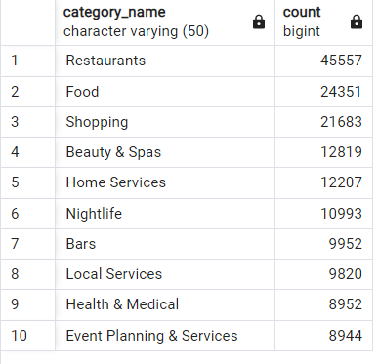
Businesses accepting credit cards
Q12. select the op 10 business categories where the business accepts credit cards.

Slide 18

Average of useful reviews
Q13.What is the average length of the 100 most useful reviews.

Slide 19
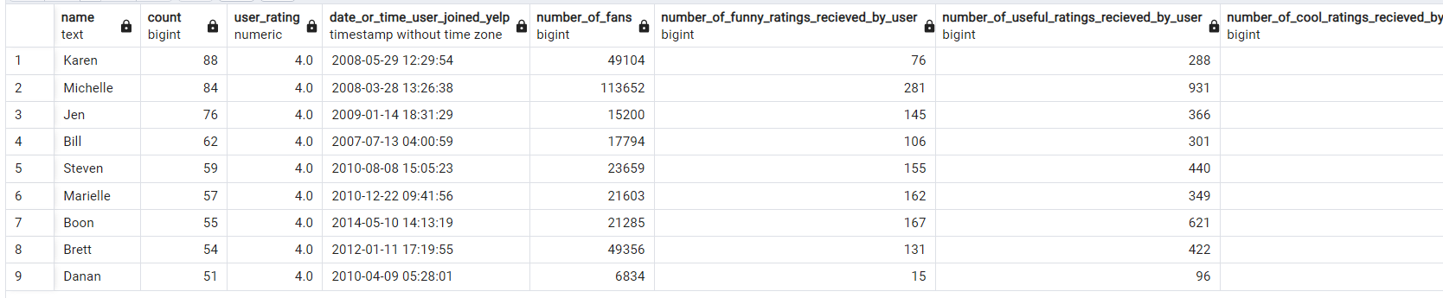
Q14. Which of our users have 4 star ratings greater than 50. Give their names, date when they joined Yelp,their total no. of fans, their total no. of funny ratings,useful ratings and cool ratings recieved by them.

Slide 20
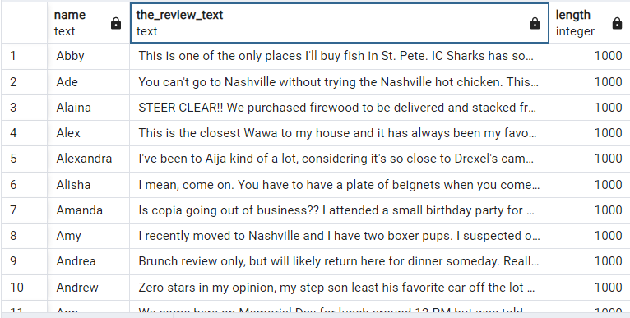
Q15.Give us the users along with their reviews who have got the highest number of cool reviews and having a length of 1000.

Slide 21
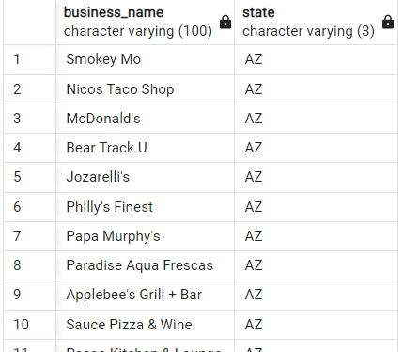
Q16.Give us the list of restaurants name which are in the state of Arizona.

Slide 22
Part 2: Personal Presentation

Slide 23
Instructions
The next slide gives questions for you to answer about your experience in this class learning about database management systems.
Add a new slide for each question.
Give the slide a short, but descriptive title
Put the question you are answering on the slide.
Use text, images, and graphs to answer the question.
Please pay attention to presenting your answers clearly.
You may delete this instructions slide in your final report.

Slide 24
Personal experience
What was your biggest challenge in working with this data? How did you overcome it?
What was the easiest part of the project for you (downloading the data from Moodle doesn’t count!)? What made it easy?
Was there anything that surprised you about the data?
Is there anything you wonder about how Yelp’s real data might look, how their database systems are designed, or what they do with this kind of data?
Are there any changes you would recommend to Yelp to make this data easier to work with?

Slide 25
Q1 .What was your biggest challenge in working with this data? How did you overcome it?
Ans. My biggest challenge was getting the data into the table. I was getting so many errors while inserting the data and even though Postgres was telling me what the error is, I still couldn’t understand. Eventually I searched on Google what that error means and accordingly understood what mistakes I was doing while inserting and did the necessary changes accordingly.

Slide 26
Q2.What was the easiest part of the project for you? What made it easy?
Ans. Creating the database and tables was the easiest thing to do because their syntax is very simple.

Slide 27
Q3 Was there anything that surprised you about the data?
Ans. In the user elite years table, in the year’s column, there were years with 2 digits, which was quite surprising.
Another thing that really surprised me was while inserting the file into the reviews table, there was a particular user which didn’t exist in the user’s table which is logically not possible but still, it was showing like that. So I had to remove the FK constraint on the user id in the reviews table.

Slide 28
Q4. Is there anything you wonder about how Yelp’s real data might look, how their database systems are designed, or what they do with this kind of data?
Ans. The real data must be humongous because Yelp is a very popular website and its users must be in millions. I think their databases are designed in a way that will speed up data retrieval, minimize storage. Their databases must be in various locations and even if one server crashes, they know how to retrieve data from that crashed server or they might be copying their data in different servers .

Slide 29
Q5.Are there any changes you would recommend to Yelp to make this data easier to work with?
Ans. To check for any anomalies in the dataset and to reduce complicated looking fields which could make working with the datasets relatively easy.

